Slide 1
STEGOSAFE: USER-FRIENDLY TOOL FOR HIDDEN IMAGE COMMUNICATION
Presented By:
NAME - Aamir Kamal
COLLEGE NAME - Vellore Institute of Technology
DEPARTMENT - B.Tech Computer Science and Engineering

Slide 2
OUTLINE
Problem Statement
System Development Approach
Algorithm & Deployment (Step by Step Procedure)
Result
Conclusion
Future Scope
References

Slide 3
PROBLEM STATEMENT
In today's digital age, traditional password-based authentication methods are increasingly vulnerable to phishing, data breaches, and brute-force attacks. Two- Factor Authentication (2FA) adds a layer of security but often requires third-party apps or SMS codes, which can be intercepted or inconvenient. Many users struggle with complex authentication processes, reducing overall system usability. Current solutions fail to balance security and ease of access effectively. Therefore, there is a growing need for a robust, user-friendly image-based authentication system.

Slide 4
PROPOSED SOLUTION
The proposed system uses digital image steganography to securely hide messages inside images without making them noticeable.
Unlike encryption, which makes the presence of confidential data obvious, this
system ensures that sensitive information remains undetectable.
A web-based interface makes it easy to use, allowing users to upload an image, enter a message, and encode it seamlessly. The system efficiently retrieves hidden messages without affecting image quality. It improves security, accessibility, and ease of use compared to existing steganography tools.

Slide 5
SYSTEM APPROACH
System Requirements Software Requirements:
Operating System: Windows 10 or later / Linux
Frontend: HTML, CSS, JavaScript
Backend: Python (3.7 or later), Flask
IDE: PyCharm / VS Code
Hardware Requirements:
Processor: Intel i5 or higher
RAM: Minimum 8 GB (16 GB recommended)
Hard Disk: 512 GB or more

Slide 6
LIBRARIES USED
OpenCV (cv2):Used for image processing tasks such as reading, writing, and modifying images. Helps manipulate pixel values to embed and extract hidden messages.
NumPy (numpy) : Handles numerical operations on image data. Converts images into arrays for easy pixel manipulation .Makes bit-level operations efficient while embedding or extracting messages.
PIL (Pillow - PIL.Image):Provides easy handling of image files in various formats like PNG and JPEG. Supports image loading, saving, and modification.
Flask (flask): Creates a web-based interface for users to upload and download images. Handles requests for encoding and decoding messages.

Slide 7
ALGORITHM & DEPLOYMENT
Requirement Analysis & Research
  Understand the limitations of traditional authentication methods.
  Explore the use of QR codes and steganography for secure communication.
  Finalize tools, libraries, and frameworks for implementation.
Environment Setup
  Install Python (v3.7+), Flask, OpenCV, Pillow, qrcode, pyzbar, NumPy.
  Set up the project folder structure for frontend and backend development.
QR Code Generation Module
  Create a function to generate a QR code from encrypted user/session data.
  Save it as an image for display or steganographic embedding.
Image Embedding (Optional)
  If using steganography, embed the QR code or data inside another image using LSB (Least Significant Bit) or other techniques.

Slide 8
Backend Integration with Flask
  Create Flask routes for QR code generation and decoding.
  Handle uploaded images and decode QR or hidden data securely.
QR Code Decoding & Validation
  Use OpenCV and pyzbar to decode scanned/uploaded QR images.
  Match the decoded content with session/authentication data.
Testing and Validation
  Test with multiple image formats, data types, and attack scenarios.
  Validate speed, accuracy, and data integrity.
Security Enhancements
  Add optional encryption layers before QR generation.
  Implement secure session management and token validation.
Deployment
Host the Flask app on a local or cloud server (e.g., Heroku, Render).
Deploy the frontend and backend as an integrated solution.
Monitor performance and prepare documentation.

Slide 9
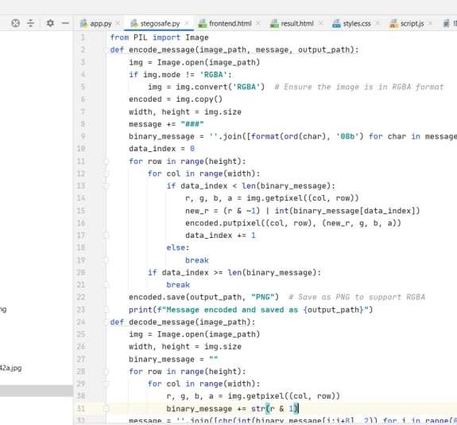
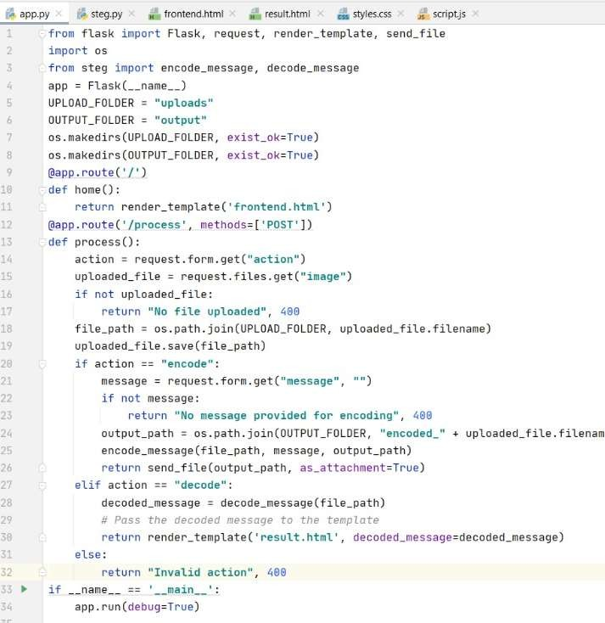
RESULT
CODE

Slide 10
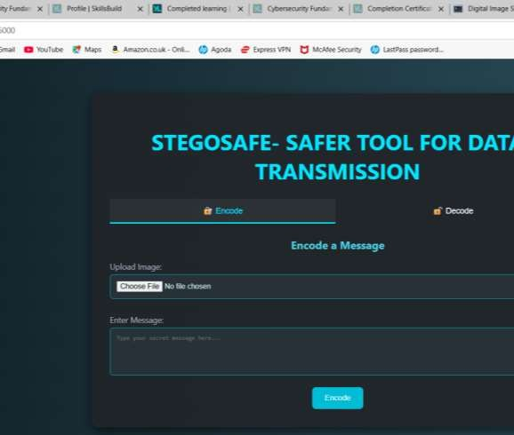
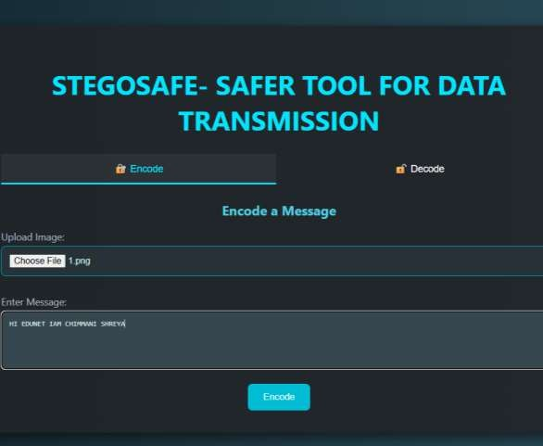
OUTPUT SCREENS

Slide 11
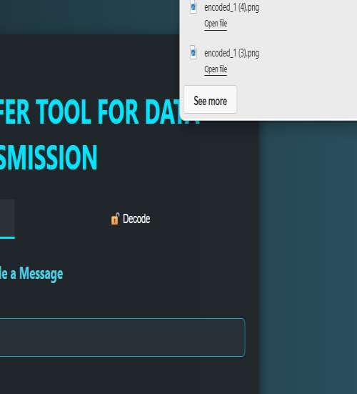
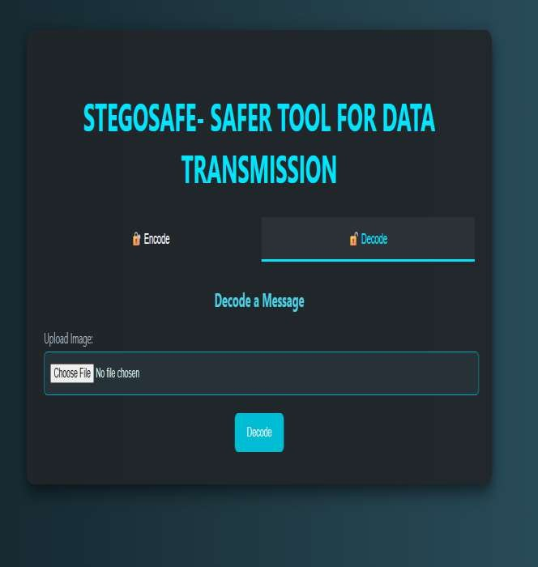

Slide 12
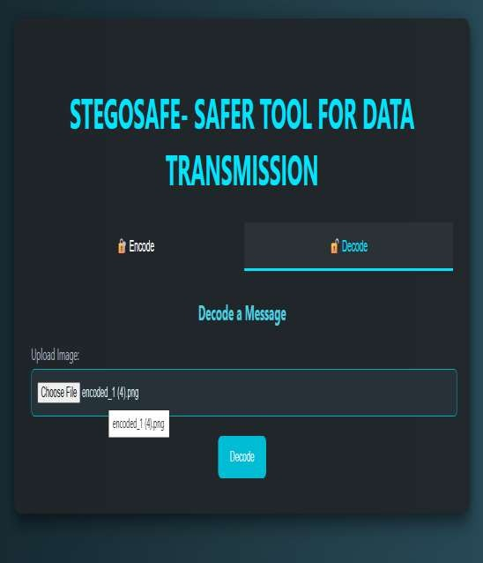
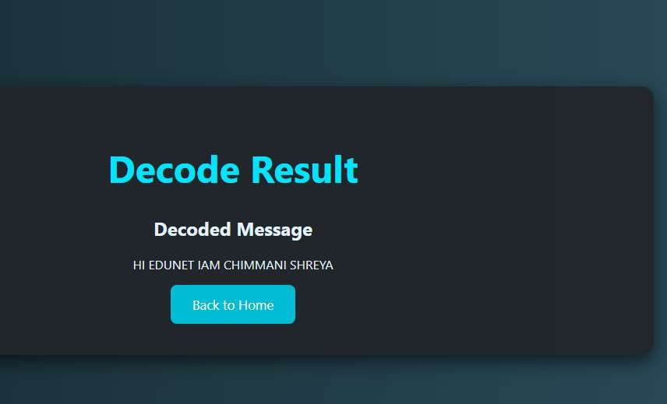

Slide 13
GITHUB REPOSITORY LINK
◾
https://github.com/Lustrouscause07/Steganography-Project.git

Slide 14
CONCLUSION
The STEGOSAFE project successfully demonstrates a practical, secure, and user- friendly solution for hiding and retrieving sensitive information within digital images using steganography. By integrating modern web technologies and image processing libraries, the system allows users to seamlessly encode and decode messages through a clean and intuitive interface. Unlike traditional encryption methods that draw attention, STEGOSAFE ensures that confidential data remains hidden in plain sight. This project highlights the potential of combining security with usability, offering a valuable tool for secure communication in both personal and professional environments.

Slide 15
FUTURE SCOPE(OPTIONAL)
Support for Multiple File Types
Extend support to embed and extract messages from audio and video files in addition to images.
Mobile-Friendly Interface
Develop a responsive version or a dedicated mobile app for on-the-go encoding and
decoding.
Advanced Encryption Integration
Combine steganography with AES or RSA encryption to further strengthen message
security before embedding.
Drag-and-Drop File Upload
Improve user experience by allowing drag-and-drop image uploads with live previews.

Slide 16
REFERENCES
Provos & Honeyman – “Hide and Seek: Intro to Steganography,” IEEE, 2003.
Darabseh et al. – “Image Steganography Using LSB & Edge Detection,” Springer, 2020.
Morkel et al. – “Overview of Image Steganography,” Univ. of Pretoria, 2005.
OpenCV Docs – QR Code Detection and Decoding.
https://docs.opencv.org/
Flask Docs – Python Web Framework Guide.

Slide 17
THANK YOU
- AAMIR KAMAL

